Slide 1




BITS Pilani
Pilani Campus
(some slides adapted from Dan Klein and Pieter Abbeel http://aima.cs.berkeley.edu/)
DSE CL 557 - Artificial and Computational Intelligence
#8. Constraint Satisfaction Problems
Sunday, October 18, 2020
Dr. Saikishor Jangiti

Slide 2
Today
Constraint Satisfaction Problem:
Formulating a CSP problem
Constraint propagation
Sudoku as CSP and constraint propagation to solve
Local search for CSP (Using 8- queens problem)
Applications
Reference: Chapter 6.1, 6.2 & 6.4 from AI: A modern approach (Russell, Norvig)

Slide 3
Constraint Satisfaction Problems
N variables
domain D
constraints
x₂
x₁
states
goal test
successor function
partial assignment
complete; satisfies constraints
assign an unassigned variable
Notes:
What is a csp? guess
coloring problem; why does this make sense as problem? silly but good representation for real world problems, e.g. scheduling tasks that need resources – can’t run 2 tasks at the same time if they need the same resource
CSPs as a search problem?

Slide 4
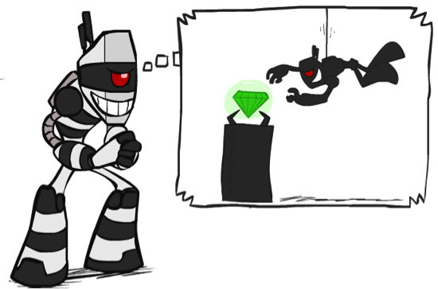

What is Search For?
Assumptions about the world: a single agent, deterministic actions, fully observed state, discrete state space
Planning: sequences of actions
The path to the goal is the important thing
Paths have various costs, depths
Heuristics give problem-specific guidance
Identification: assignments to variables
The goal itself is important, not the path
All paths at the same depth (for some formulations)
CSPs are specialized for identification problems
Notes:
Step back – these are search problems, so we can now take a look at different problems we can use search for
Before we had planning;
Ninja robot knows where the gem is, but not how to get there
Identification; detective robot wants to know where the gem is – the goal is important, not the path; what is the depth?

Slide 5


Constraint Satisfaction Problems
Standard search problems:
State is a “black box”: arbitrary data structure
Goal test can be any function over states
Successor function can also be anything
Constraint satisfaction problems (CSPs):
A special subset of search problems
State is defined by variables X_{i} with values from a domain D (sometimes D depends on i)
Goal test is a set of constraints specifying allowable combinations of values for subsets of variables
Allows useful general-purpose algorithms with more power than standard search algorithms
Notes:
Before: states were nodes, no structure, just a set, they could be anything
Goal test – like a judge; just makes decisions; you don’t know how;
Now: Goal test has structure, it ‘s more like a manual describing a set of constraints that have to hold true

Slide 6
CSP Examples
Notes:
I want you to practice formalizing real problems as search/csp problems

Slide 7


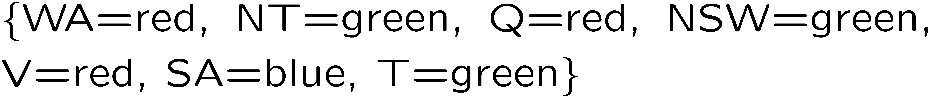
Example: Map Coloring
Variables:
Domains:
Constraints: adjacent regions must have different colors
Solutions are assignments satisfying all constraints, e.g.:
Implicit:
Explicit:
Notes:
How do you specify constraints in code/math? Implicit vs explicit. What might be explicit?

Slide 8
Constraint Graphs

Slide 9
Constraint Graphs
Binary CSP: each constraint relates (at most) two variables
Binary constraint graph: nodes are variables, arcs show constraints
General-purpose CSP algorithms use the graph structure to speed up search. E.g., Tasmania is an independent subproblem!
Notes:
Demo:
Run constraint.jar or constraint.exe, load the 5 queens problem.
Demo is just showing the n-queens applet as illustration of constraint graph, but later in lecture we’ll interact with the applet.
aispace.org will have the latest version

Slide 10


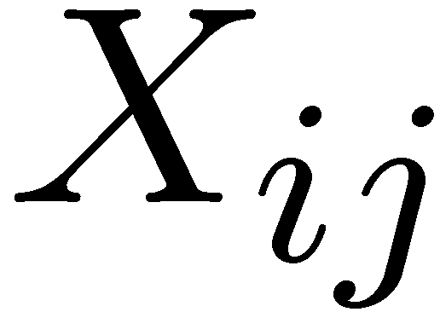

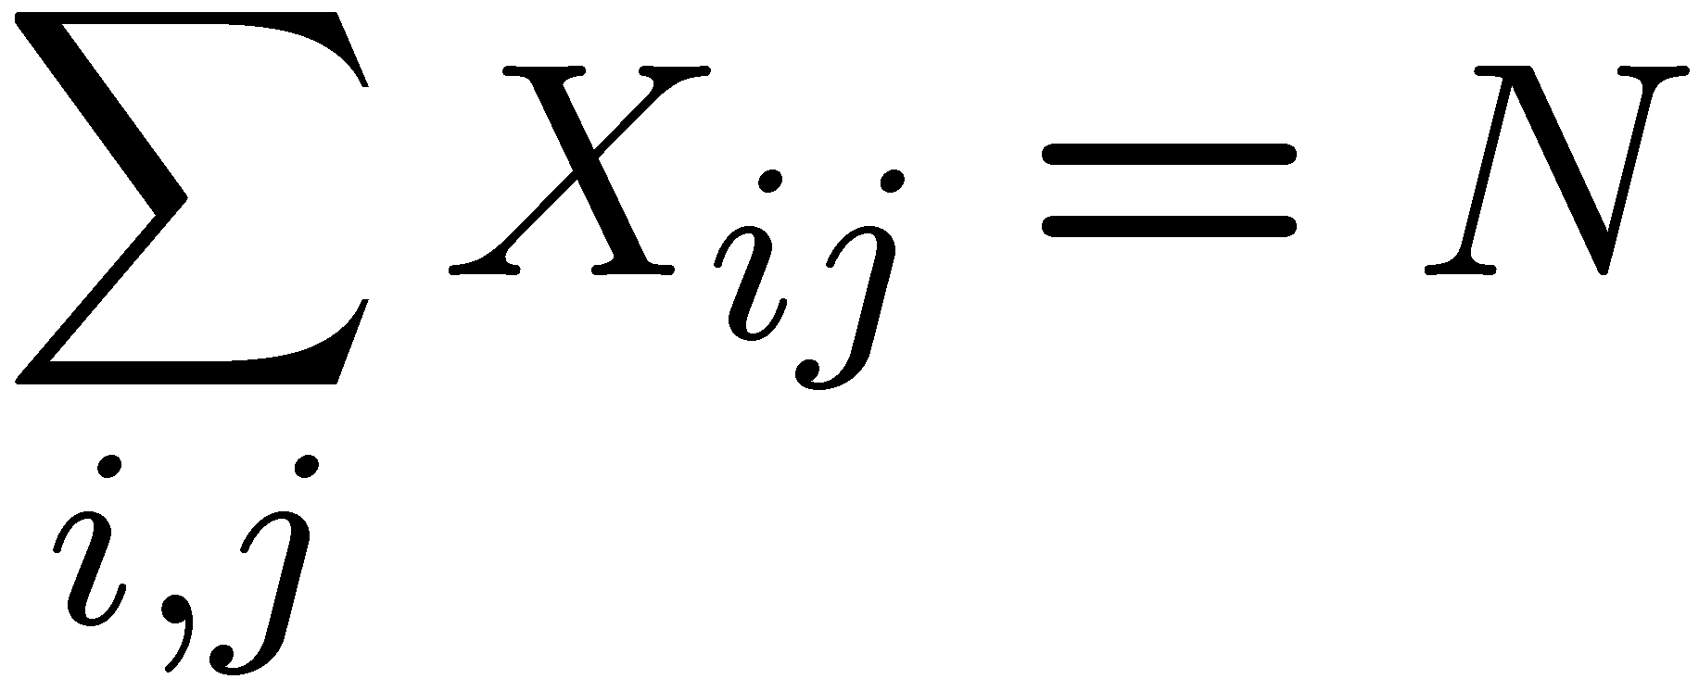
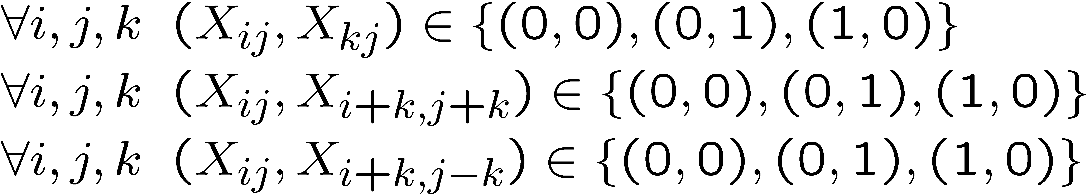
Example: N-Queens
Formulation 1:
Variables:
Domains:
Constraints
Notes:
Are these constraints enough? No, there should be N queens there.

Slide 11







Example: N-Queens
Formulation 2:
Variables:
Domains:
Constraints:
Implicit:
Explicit:

Slide 12


Example: Cryptarithmetic
X₁
Variables:
Domains:
Constraints:
Notes:
0=7, R=4, W=6, U=2, T=8, F=1; 867 + 867 = 1734

Slide 13
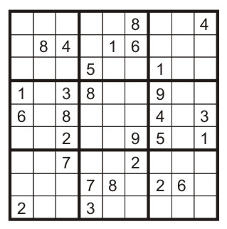
Example: Sudoku
Variables:
Each (open) square
Domains:
{1,2,…,9}
Constraints:
9-way alldiff for each column
9-way alldiff for each row
9-way alldiff for each region
(or can have a bunch of pairwise inequality constraints)

Slide 14
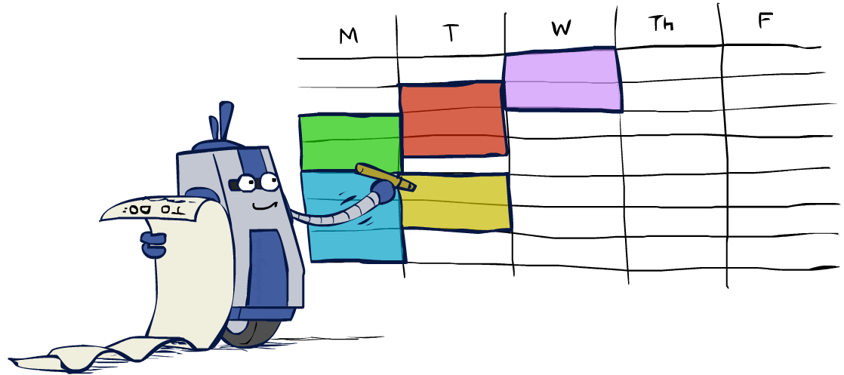
Real-World CSPs
Assignment problems: e.g., who teaches what class
Timetabling problems: e.g., which class is offered when and where?
Hardware configuration
Transportation scheduling
Factory scheduling
Circuit layout
Fault diagnosis
… lots more!
Many real-world problems involve real-valued variables…

Slide 15

Solving CSPs

Slide 16
Standard Search Formulation
Standard search formulation of CSPs
States defined by the values assigned so far (partial assignments)
Initial state: the empty assignment, {}
Successor function: assign a value to an unassigned variable
Goal test: the current assignment is complete and satisfies all constraints
We’ll start with the straightforward, naïve approach, then improve it

Slide 17
Search Methods
What would BFS do?
{}
{WA=g}
{WA=r}
…
{NT=g}
…
Notes:
Where is the goal? If BFS were a person, this is what would keep it up at night.
Demo:
CS188 javascript demos -> source -> exercises -> csps -> CSPs demos -> CSPs demos.html
Settings:
Graph = Simple
Algorithm = Naïve Search
Ordering = None
Filtering = None

Slide 18
Search Methods
What would BFS do?
What would DFS do?
let’s see!
Notes:
Demo:
CS188 javascript demos -> source -> exercises -> csps -> CSPs demos -> CSPs demos.html
Settings:
Graph = Simple
Algorithm = Naïve Search
Ordering = None
Filtering = None

Slide 19

Video of Demo Coloring -- DFS

Slide 20

Filtering
Keep track of domains for unassigned variables and cross off bad options

Slide 21
Filtering: Forward Checking
Filtering: Keep track of domains for unassigned variables and cross off bad options
Forward checking: Cross off values that violate a constraint when added to the existing assignment
WA
NT
Q
SA
NSW
V
Notes:
Demo:
CS188 javascript demos -> source -> exercises -> csps -> CSPs demos -> CSPs demos.html
Settings:
Graph = Simple
Algorithm = Backtracking
Ordering = None
Filtering = Forward Checking

Slide 22
Video of Demo Coloring – Backtracking with Forward Checking

Slide 23
Filtering: Constraint Propagation
Forward checking propagates information from assigned to unassigned variables, but doesn't provide early detection for all failures:
NT and SA cannot both be blue!
Why didn’t we detect this yet?
Constraint propagation: reason from constraint to constraint
NT
Q
WA
SA
NSW
V
Notes:
We’ve already failed, but forward checking does not detect that.

Slide 24

Consistency of A Single Arc
An arc X → Y is consistent iff for every x in the tail there is some y in the head which could be assigned without violating a constraint
Forward checking?
Enforcing consistency of arcs pointing to each new assignment
NT
Q
WA
SA
NSW
V
Delete from the tail!
Notes:
Mnemonic – csp police checks my trunk

Slide 25
Arc Consistency of an Entire CSP
A simple form of propagation makes sure all arcs are consistent:
Important: If X loses a value, neighbors of X need to be rechecked!
Arc consistency detects failure earlier than forward checking
Can be run as a preprocessor or after each assignment
What’s the downside of enforcing arc consistency?
NT
Q
WA
SA
NSW
V
Remember: Delete from the tail!
Notes:
remids you of a* - heuristic takes time

Slide 26
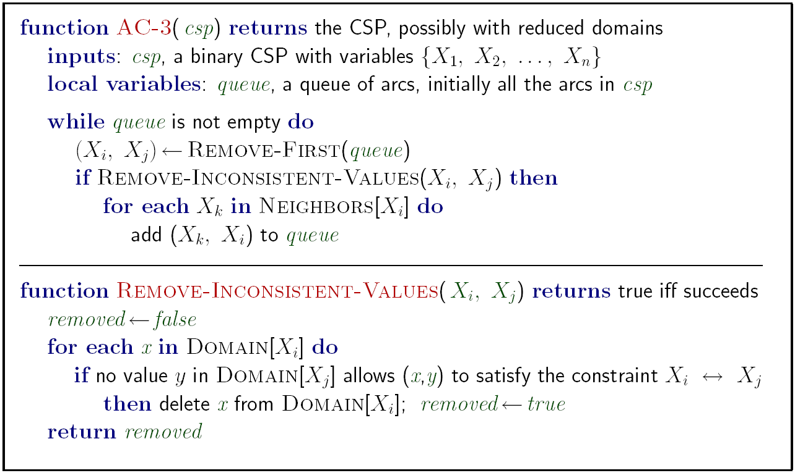
Enforcing Arc Consistency in a CSP
Runtime: O(n²d³), can be reduced to O(n²d²)
… but detecting all possible future problems is NP-hard – why?
Notes:
Auto-consistency (note initially nothing gets deleted/pruned since there are consistent options for all constraints for initial variable domains)
Flashes whenever something needs to be re-checked
n^2*d*d^2

Slide 27


Limitations of Arc Consistency
After enforcing arc consistency:
Can have one solution left
Can have multiple solutions left
Can have no solutions left (and not know it)
Arc consistency still runs inside a backtracking search!
Notes:
Demo:
CS188 javascript demos -> source -> exercises -> csps -> CSPs demos -> CSPs demos.html
Settings:
Graph = Complex
Algorithm = Backtracking
Ordering = None
Filtering = Forward Checking (first) / Arc Consistency (second)

Slide 28
Thank you for your Attention
Any more queries

